Slide 1
IRRI Myanmar Rice Sector Development Strategy
Dr. Jongsoo SHIN
IRRI Myanmar Representative

Slide 2
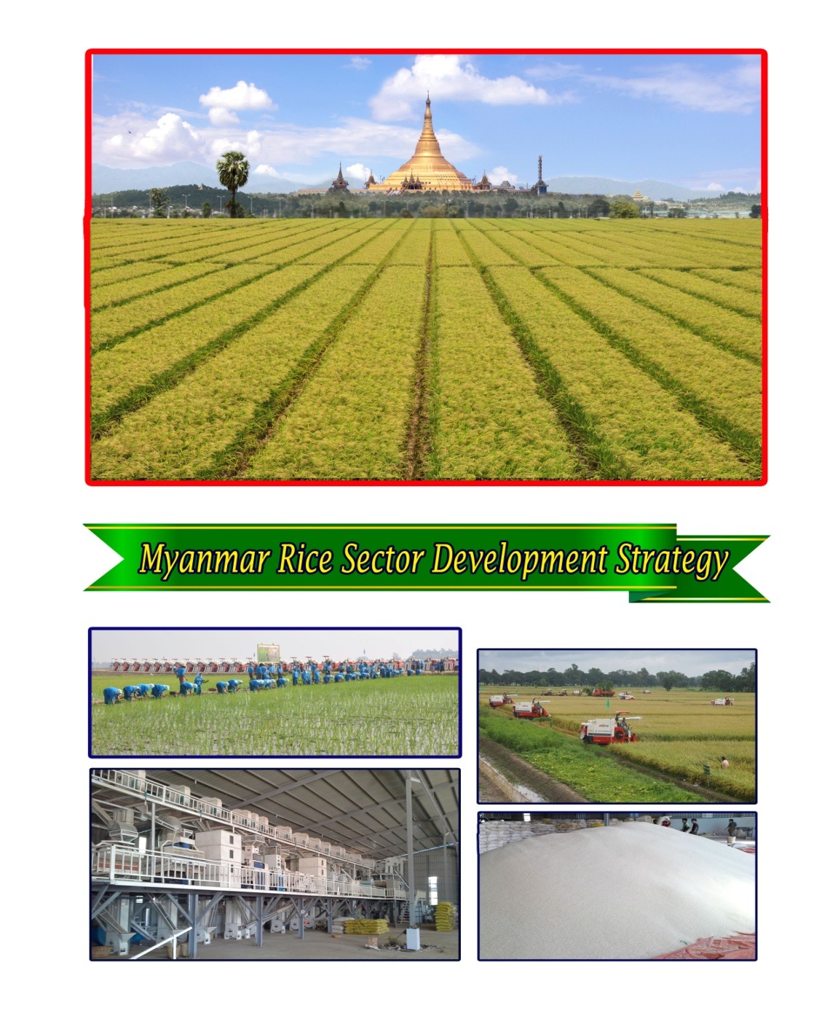
By 2030, Myanmar envisions food-secure farmers and consumers enjoying the economic benefits provided by a transformed, dynamic, environmentally sustainable, and internationally competitive rice sector.
The ultimate goal of the rice sector strategy is a food-secure nation where smallholder farming households have tripled their household incomes, including income derived from rice and rice-based farming, thereby enjoying a decent standard of living comparable to urban dwellers.

Slide 3
Objectives
Increase rice productivity; improve quality and nutritional value
Adapt to/mitigate effects of climate change and reduce risk, while protecting rice ecosystems and the environment
Promote Myanmar rice as a quality brand to enhance competitiveness in international trade
Improve well-being and enhance capacity of smallholder farmers, including women and children
Enhance efficiency in the rice value chain and reduce postharvest losses

Slide 4
Constrains of Rice sector in Myanmar
Rice R&D in Governmental Research station
Productivity of rice production systems (Variety, technology and input)
Rural infrastructure increases input prices and reduces output prices (Road and Electricity)
Unresolved land tenure issues increase risks of investing in land improvements
Access to knowhow, electricity and finance slows down the modernization of milling industry.
High port charges and export procedure and Myanmar’s export competitiveness.

Slide 5
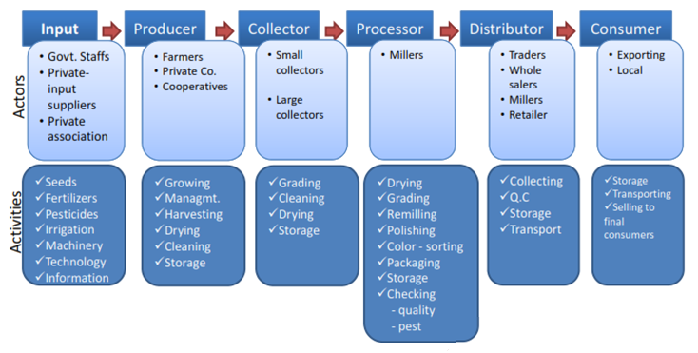
Rice Value chain in Myanmar

Slide 6
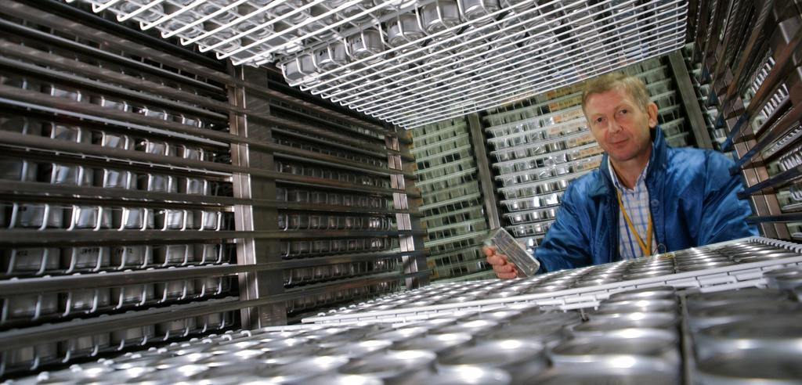
Rice genetic diversity
127,000 varieties of rice conserved in the IRRI International Rice Genebank

Slide 7
Environmental stress impact on Yield Loss

Slide 8
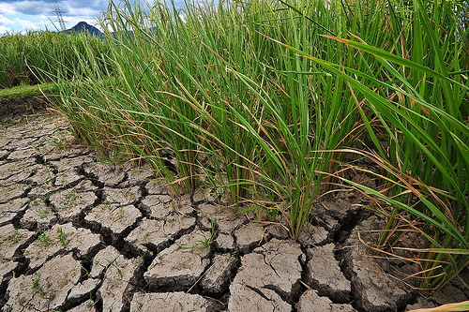
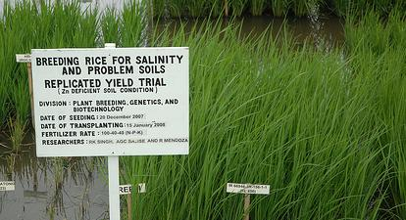
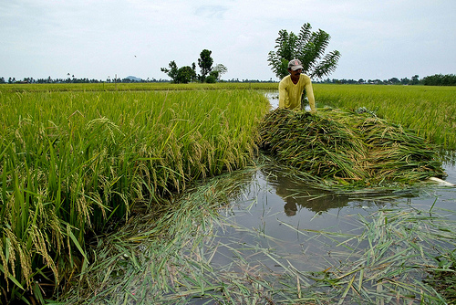

Rice ready for climate change
salinity
drought
heat
submergence

Slide 9
Increasing Marketing share

Slide 10
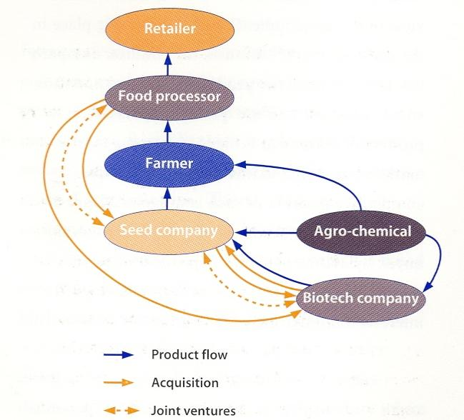
Partnership & Vertical Integration

Slide 11
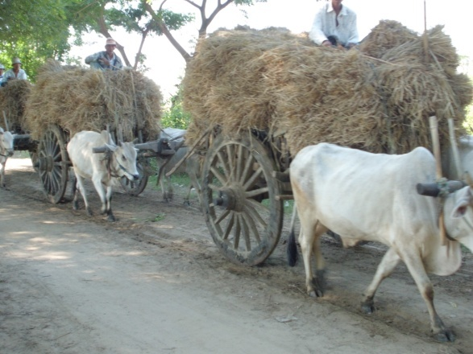
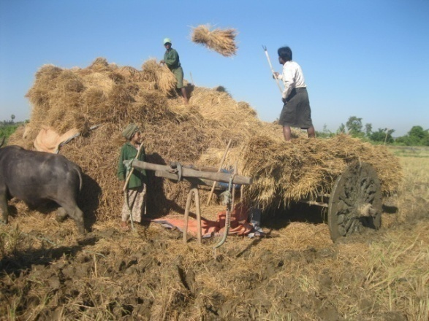
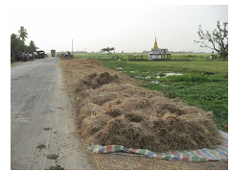
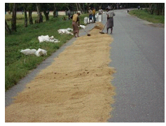
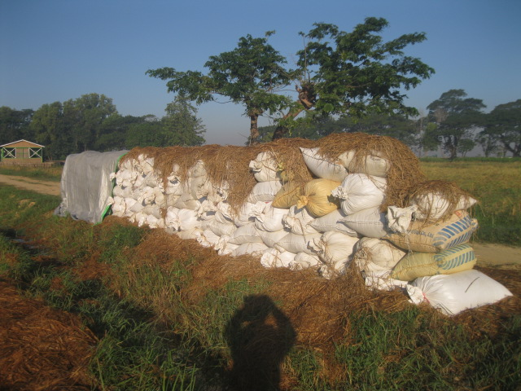
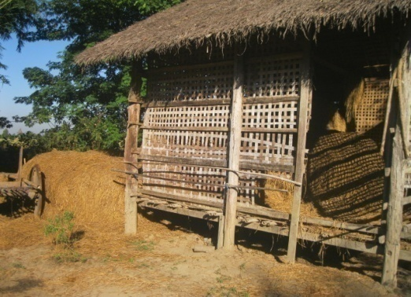

Slide 12
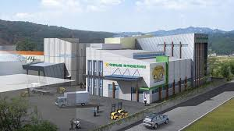
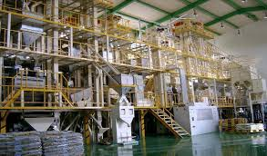


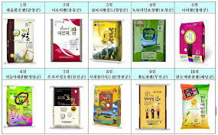
Rice Processing Complex(RPC)

Slide 13
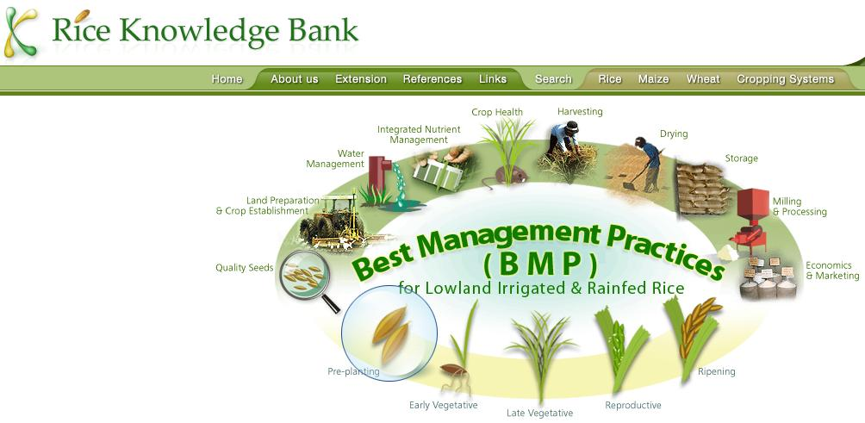
Rice Knowledge Bank
Notes:
Do live demo to find fact sheets in RKB
13

Slide 14
The IRRI MRSDS will…
Guide the government in prioritizing its investments to improve the structural weaknesses along the rice value chain.
Help international donors and partners align their agricultural development initiatives to complement government efforts.
Guide the government in reviewing and revising current policies that stifle the sector and formulate new ones to stimulate investments from the private sector and foreign investors.

Slide 15
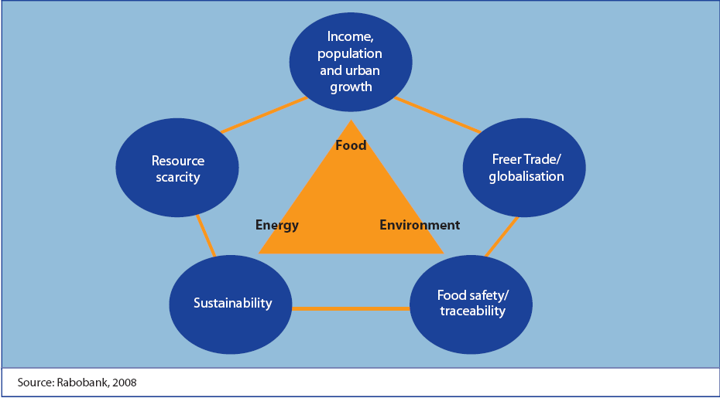

Slide 16
All our dreams can come true
if we go together!
Therefore,
IRRI will always be with you !

